Slide 1
Power BI Dashboard – Global Sales and Profit Analysis
Aishwarya P
26 June,2025

Slide 2
Objective
Analyze sales and profit performance across statesVisualize discount impact on productsUnderstand time-based sales trends

Slide 3
Key Insights from the Dashboard
State-wise Sales DistributionVisualization: Pie Chart - Sum of Sales by Quantity
Profit & Sales SummaryKPIs Displayed:Sum of Profit: 9.98KSum of Sales: 27.45KProfit by Sales: 5.04K
Product Discount AnalysisVisualization: Area Chart - Count of Product ID by Discount
Time Series AnalysisVisualization: Bar Chart - Count of Order ID by Order Date
Filter Usage - StateFeature: State filter for dynamic report customization

Slide 4
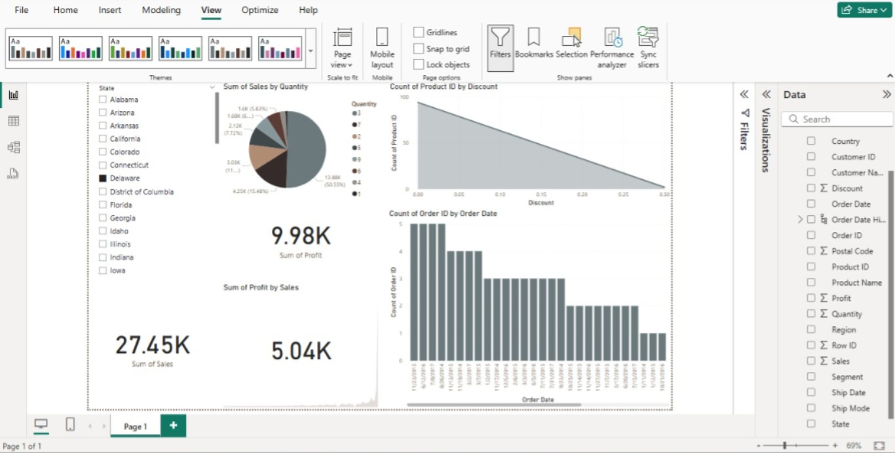
Power BI Dashboard Preview

Slide 5
Conclusion
Delaware is a key market based on quantityLower discounts are more commonConsistent sales and profit performanceRecommendations:Focus on high-performing statesReview discount strategyConsider seasonal patterns for future planning

